Slide 1
Object Oriented Programming
(SENG6022)
Arba Minch University
Institute of Technology
Faculty of Computing & Software Engineering
Mr. Addisu M. (Asst. Prof)
G2 SE - Regular

Slide 2
Inheritance
Chapter Five

Slide 3
Outline
01
Introduction
02
Types of Inheritance
03
Rules of Inheritance
04
Method Overriding

Slide 4
Introduction to Inheritance
  Often programmers find themselves designing classes with many similarities.
    How can we take advantage of these similarities to reduce the amount of code we write?
    How can we take advantage of these similarities to write code which is less likely to contain errors?
    How can we take advantage of existing code when we want to design something similar to the existing code?

Slide 5

Inheritance in Java
  Mechanism of deriving new class from old class
    You simply state which class you want to inherit from in order to gain its members (fields and methods)
    You can add new methods & fields in your current class also
  As we know, child inherits properties from his parents
    similar concept is followed in Java - two classes:
  Old class – a class whose properties are inherited is known as Base Class / Super class / Parent Class
  New class – a class which inherits the properties is known as Derived class/ Sub Class / Child class

Slide 6
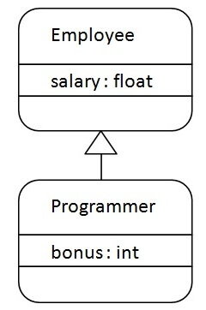
Inheritance in Java
  It represents the IS-A relationship which is also known as a parent-child relationship
  Inheritance helps in reusing the code and establish a relationship between different classes
  Programmer is subclass and Employee is superclass
    Relationship: Programmer IS-An Employee
    Means: Programmer is a type of Employee (Programmer can inherit from Employee)

Slide 7
Inheritance in Java
class Subclass-name extends Superclass-name {
//methods and fields
}
  Syntax:
  class Subclass-name is inheriting the properties and methods of Superclass-name class
  extends keyword indicates that you are making a new class that derives from an existing class
class Employee { float salary=40000; }
class Programmer extends Employee{
  int bonus=10000;
  public static void main(String args[]){
    Programmer p=new Programmer();
    System.out.println("Programmer salary is:“ + p.salary);
    System.out.println("Bonus of Programmer is:“ + p.bonus);
  }
}

Slide 8
Inheritance in Java
  Example:
class Animal {
  String name;
  public void eat() {
  System.out.println("I can eat");
  }
}
class Dog extends Animal {// inherit from Animal
  public void display() {
  System.out.println("My name is " + name);
  }
}
class Main {
  public static void main(String[] args) {
    Dog dog1 = new Dog();
    dog1.name = “Bobi";
    dog1.display();
    dog1.eat();
  }
}

Slide 9
Inheritance in Java
class Teacher{
  String designation = "Teacher";
  String collegeName = "Edureka";
  void does(){
  System.out.println("Teaching");
  }
}
public class HadoopTeacher extends Teacher{
  String mainSubject = "Spark";
  public static void main(String args[]){
  HadoopTeacher obj = new HadoopTeacher();
    System.out.println(obj.collegeName);
    System.out.println(obj.designation);
    System.out.println(obj.mainSubject);
    obj.does();
  }
}

Slide 10
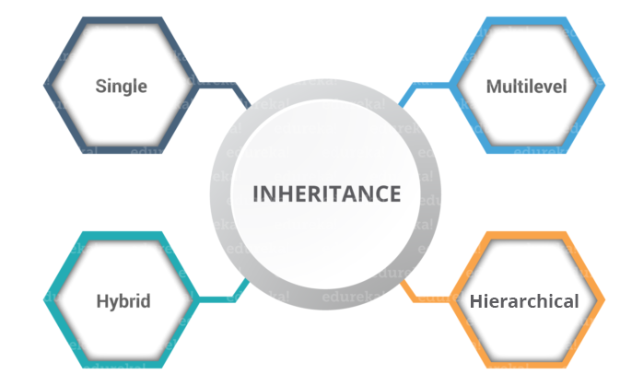
Types of Inheritance
  Single
  Multilevel
  Multiple
  Hierarchical

Slide 11

Types of Inheritance
  Single inheritance
  When a class extends another one class only then we call it a single inheritance
  The below flow diagram shows that class B extends only one class which is A
  Here A is a parent class of B and B would be a child class of A.

Slide 12
Types of Inheritance
  Single inheritance
class Animal{
void eat(){ System.out.println(“eating”); }
}
class Dog extends Animal{
void bark(){ System.out.println(“barking”); }
}
class TestInheritance{
  public static void main(String args[]){
    Dog d=new Dog();
    d.bark();
    d.eat();
  }
}

Slide 13
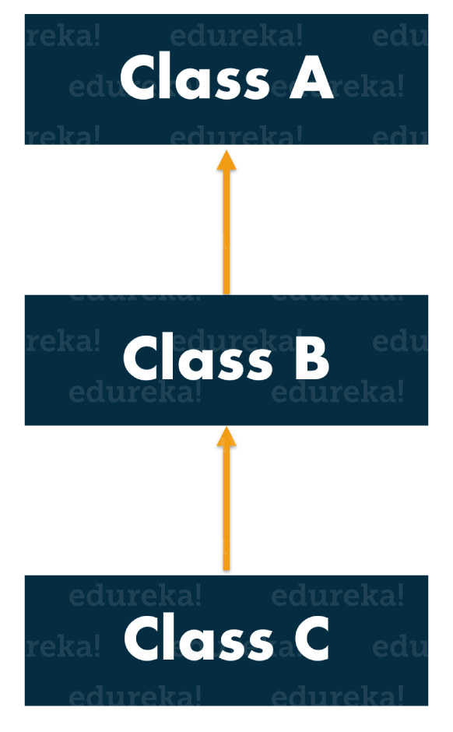
Types of Inheritance
  Multi-level inheritance
  a class is derived from a class which is also derived from another class, i.e. a class having more than one parent class but at different levels
    B inherits the properties and behavior of A and C inherits the properties of B
    Class C implicitly inherits the
    properties and methods of class A
    along with Class B

Slide 14
Types of Inheritance
  Multi-level inheritance
class Animal{
void eat(){ System.out.println(“eating…”); }
}
class Dog extends Animal{
void bark(){ System.out.println(“barking…”); }
}
class Puppy extends Dog{
void weep(){ System.out.println(“weeping…”); }
}
class TestInheritance2{
  public static void main(String args[]){
    Puppy d=new Puppy();
    d.weep();
    d.bark();
    d.eat();
  }
}

Slide 15
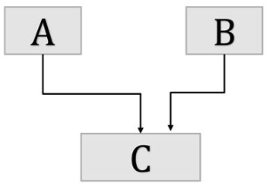
Multiple Inheritance
  Multiple Inheritance - concept of one class extending (Or inherits) more than one base class
  The problem with “multiple inheritance” is that the derived class will have to manage the dependency on two base classes

Slide 16
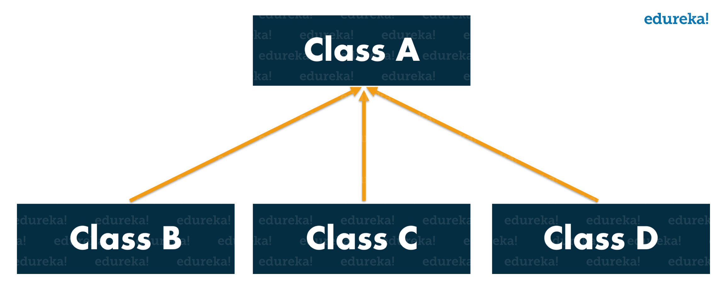
Types of Inheritance
  Hierarchical inheritance
  When a class has more than one child classes (subclasses) or in other words, more than one child classes have the same parent class
Class B, C and D are child classes which are inheriting from the parent class A

Slide 17
Types of Inheritance
  Hierarchical inheritance
class Animal{
void eat(){ System.out.println(“eating…”); }
}
class Dog extends Animal{
void bark(){ System.out.println(“barking…”); }
}
class Cat extends Animal{
void meow(){ System.out.println(“meowing…”); }
}
class TestInheritance3{
  public static void main(String args[]){
    Cat c=new Cat();
    c.meow();
    c.eat();
  }
}

Slide 18
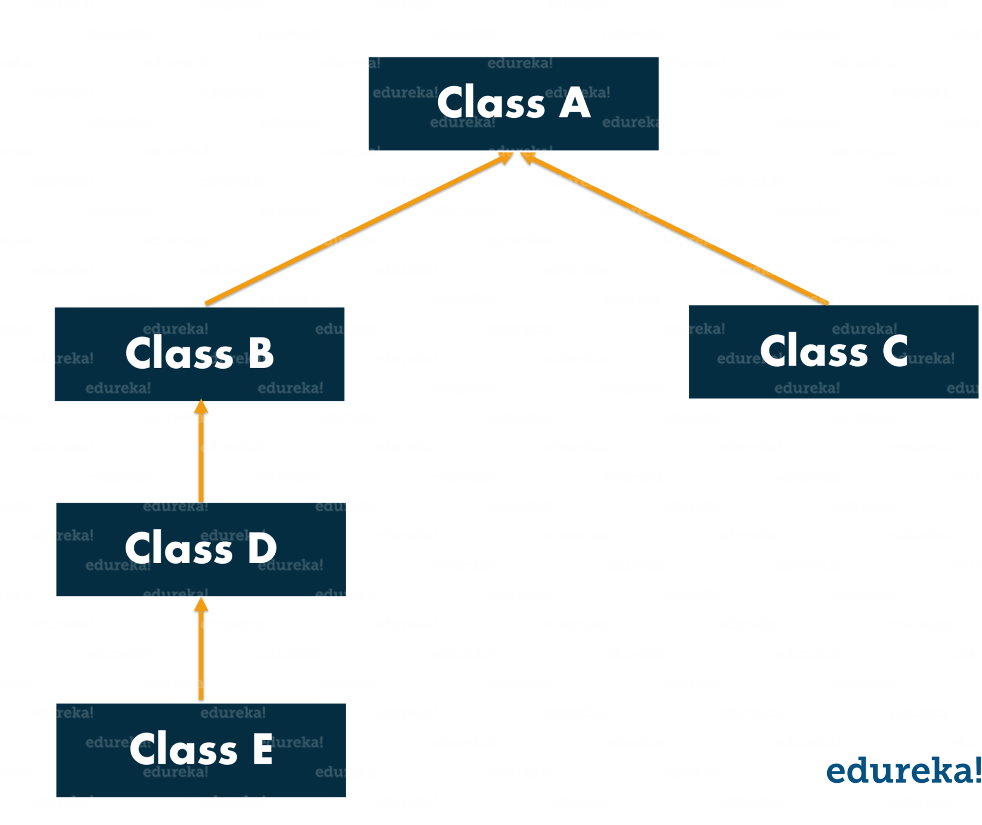
Types of Inheritance
  Hybrid inheritance
  combination of two or more types of inheritance.

Slide 19
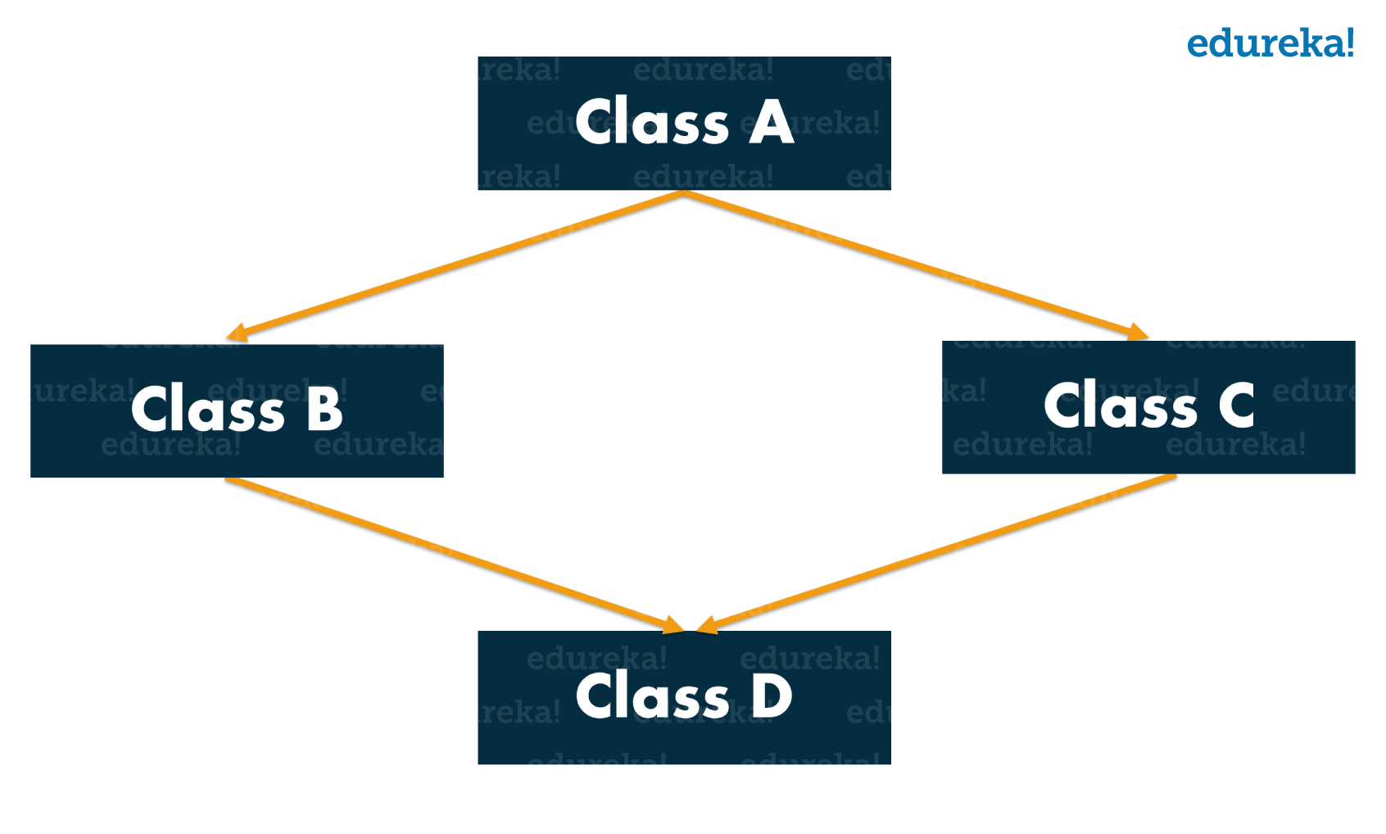
Rules of Inheritance
  RULE 1: Multiple Inheritance is NOT permitted in Java
  Multiple inheritance - process where one child class tries to extend more than one parent class
    Class A is a parent class for Class B and C, which are further extended by class D

Slide 20
Rules of Inheritance
  RULE 1: Multiple Inheritance is NOT permitted in Java
  Let, you have a method show() in both classes B and C, but with different functionalities.
    When Class D extends class B and C, it automatically inherits the characteristics of B and C including the method show().
    When you try to invoke show() of class B, compiler will get confused as to which show() to be invoked (either from class B or class C )
      it leads to ambiguity

Slide 21
Rules of Inheritance
  RULE 1: Multiple Inheritance is NOT permitted in Java
class Demo1{ //code here }
class Demo2{ //code here }
class Demo3 extends Demo1, Demo2{
//code here
}
class Launch{
  public static void main(String args[]){
  //code here
  }
}
Java renders compile-time error if you inherit 2 classes whether you have same method or different
  Demo3 is a child class which is trying to inherit two parent classes Demo1 and Demo2
    not permitted as it results in a diamond problem & leads to ambiguity
  NOTE: Multiple inheritance is not supported in Java but you can still achieve it using interfaces.

Slide 22
Rules of Inheritance
  RULE 2: Cyclic Inheritance is NOT permitted
  When a class extends itself and form a loop itself.
  both classes are trying to inherit each other’s characters which is not permitted as it leads to ambiguity
class Demo1 extends Demo2{
//code here
}
class Demo2 extends Demo1{
//code here
}

Slide 23
Rules of Inheritance
  RULE 3: Private members do NOT get inherited.
class You{
  private int an;
  private int pw;
  You{
    an =111;
    pw= 222;
  }
}
class Friend extends You{
  void change Data(){
    an =8888;
    pw=9999;
  }
  void disp(){
    System.out.println(an);
    System.out.println(pw);
  }
}
class Launch{
  public static void main(String args[]){
    Friend f = new Friend();
    f.change.Data();
    f.disp();
  }
}
When you execute this code, guess what happens, do you think the private variables an and pw will be inherited?
Absolutely not. It remains the same because they are specific to the particular class.

Slide 24
Rules of Inheritance
  RULE 4: Constructors cannot be Inherited
  constructor cannot be inherited, as the subclasses always have a different name
  You can do only:
class A {
A();
}
class B extends A{
B();
}
B b = new B(); // and not new A()
Notes:
https://www.edureka.co/blog/inheritance-in-java/

Slide 25
Sub Class Constructor
  subclass constructor is used to construct the instance variables of both the subclass and the superclass
  subclass constructor uses the keyword super to invoke the constructor method of superclass
  super Keyword is used with following Conditions
    super may only be used within a subclass constructor
    The call to super must appear as first statement
    Parameters in the super call must match with declaration in superclass

Slide 26
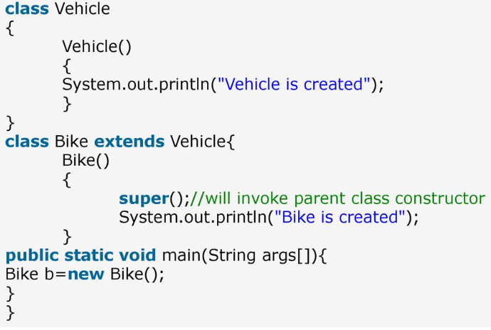
Sub Class Constructor

Slide 27
Overriding Methods
  If subclass (child class) has the same method as declared in the parent class, it is known as method overriding
  Advantage of Method Overriding
    provide specific implementation of a method that is already provided by its super class.
  Rules for Method Overriding
    method must have same name as in the parent class
    method must have same parameter as in the parent class
    .must be IS-A relationship (inheritance)

Slide 28
Overriding Methods
class Animal {
  public void eat() {
  System.out.println("I can eat");
  }
}
class Dog extends Animal {
  // overriding the eat() method
  @Override
  public void eat() {
  System.out.println("I eat dog food");
  }
  public void bark() {
  System.out.println("I can bark");
  }
}
class Main {
  public static void main(String[] args) {
    Dog labrador = new Dog();
    labrador.eat();
    labrador.bark();
  }
}

Slide 29
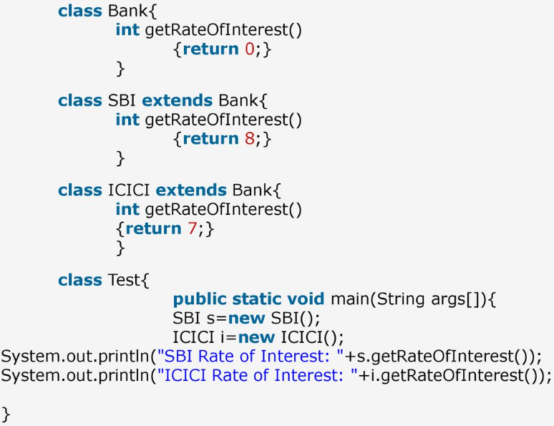
Overriding Methods

Slide 30
Inheritance in Java
Method Overloading | Method Overriding
1) Method overloading is used to increase the readability of the program. | Method overriding is used to provide the specific implementation of the method that is already provided by its super class.
2) method overloading is performed within a class. | Method overriding occurs in two classes that have IS-A relationship.
3) In case of method overloading parameter must be different | In case of method overriding parameter must be same.
Notes:
https://slideplayer.com/slide/13754107/

Slide 31
super Keyword
  Previously we saw that the same method in the subclass overrides the method in superclass.
  In such a situation, super keyword is used to call the method of the parent class from the method of the child class

Slide 32
super Keyword
class Animal {
  public void eat() {
  System.out.println("I can eat"); }
}
class Dog extends Animal {
  @Override
  public void eat() {
    super.eat();
    System.out.println("I eat dog food");
  }
  public void bark() {
  System.out.println("I can bark");
  }
}
class Main {
  public static void main(String[] args) {
    Dog labrador = new Dog();
    labrador.eat();
    labrador.bark();
  }
}
eat() method is present in both Animal and Dog class
super keyword is used to call eat() method present in superclass
We can also use super keyword to call the constructor of the superclass from the constructor of the subclass

Slide 33
protected Members
  if class includes protected fields & methods, are accessible from the subclass
  of the class
class Animal {
  protected String name;
  protected void display() {
  System.out.println("I am an animal."); }
}
class Dog extends Animal {
  public void getInfo() {
  System.out.println("My name is " + name);
  }
}
class Main {
  public static void main(String[] args) {
    Dog dog1 = new Dog();
    dog1.name = "Rocky";
    dog1.display();
    dog1.getInfo();
  }
}

Slide 34
THANKS!
Questions, Ambiguities, Doubts, … ???

